Slide 1
Image Enhancement Project
Submitted By
Farhan Ishtiyak Sezar
B190305011
Md.Rashedunnabi
B190305022
Submitted To
Dr. Md. Zulfiker Mahmud
Professor,Computer Science
and Engineering
Jagannath University,Dhaka

Slide 2
Introduction
Project Focus: Enhancing image quality through image processing techniques.
Implementation: Techniques developed using Python.
Primary Goals:
Improve brightness
Enhance contrast
Increase color saturation

Slide 3
Techniques
Gray World Color Correction
Brightness Adjustment
Local Contrast Enhancement
Color Transfer from Grayscale
Saturation Adjustment
Color Histogram Analysis

Slide 4
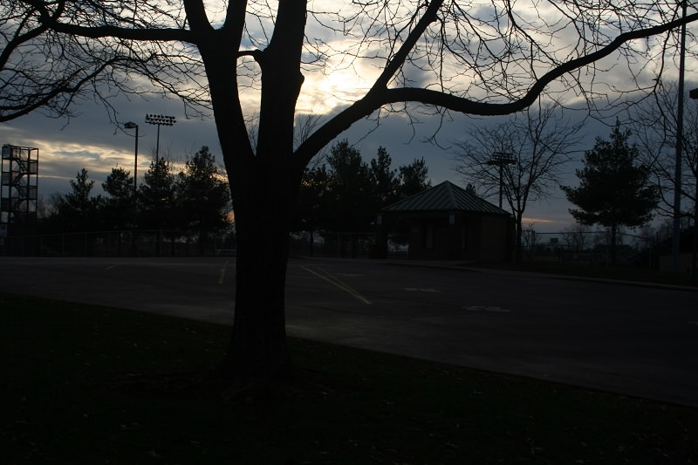
Input Image

Slide 5
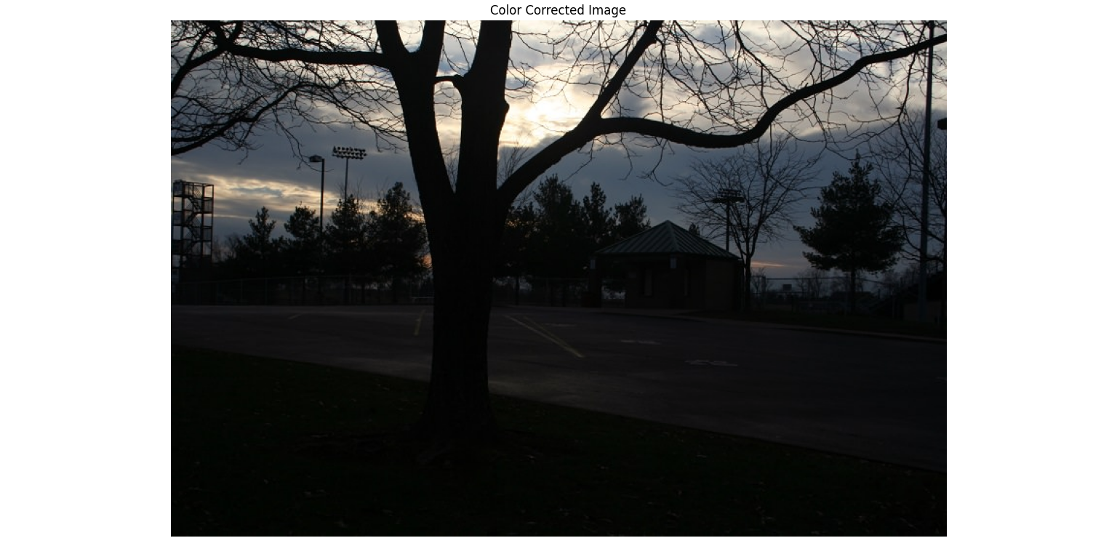
Color Correction

Slide 6
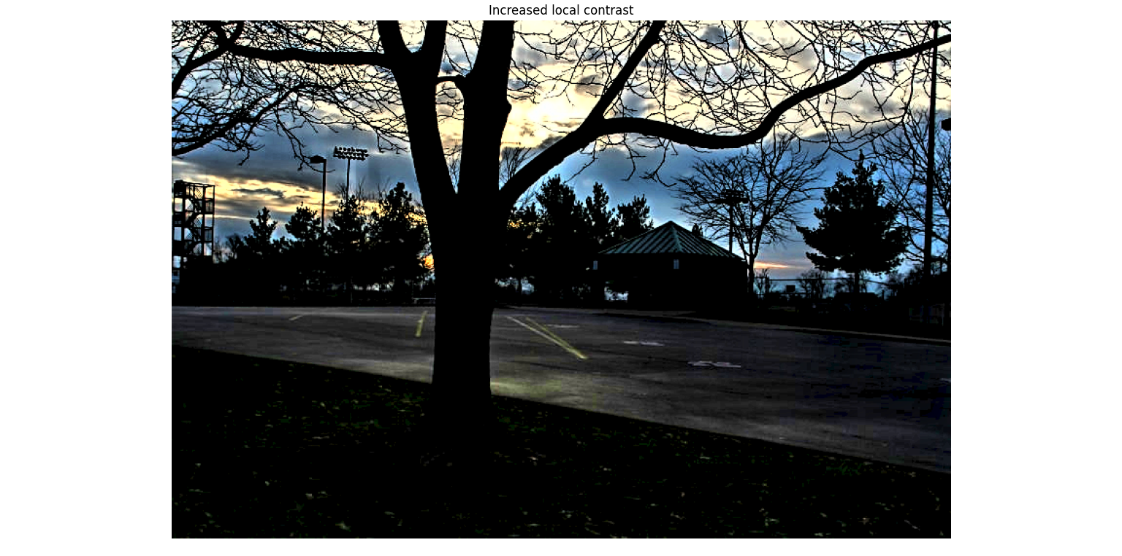
Increase Local Contrast

Slide 7
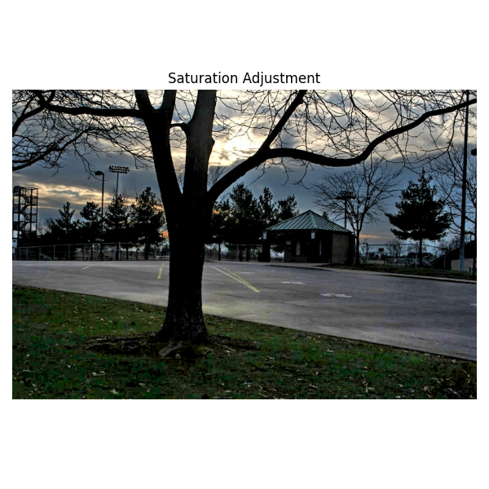
Saturation Adjustment

Slide 8
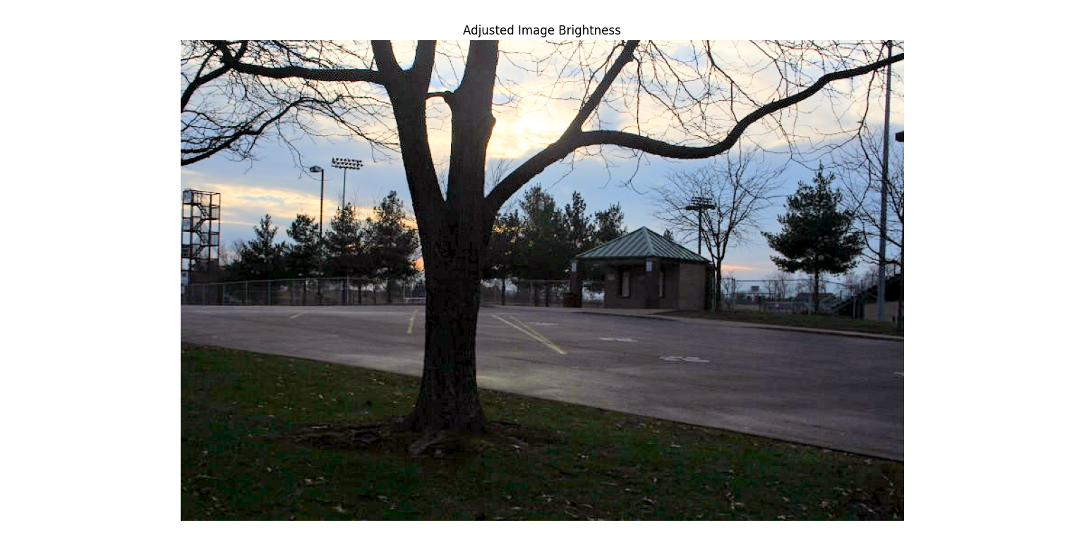
Adjusted Image Brightness

Slide 9
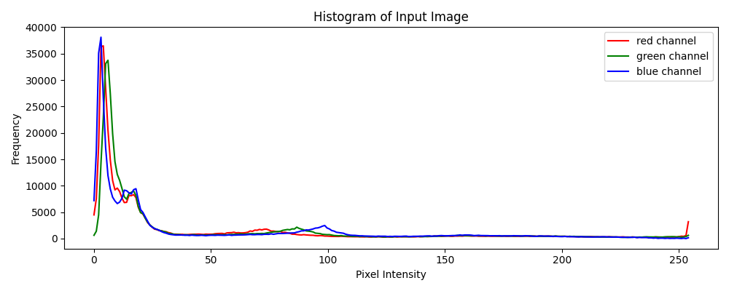
Histogram for Input Image

Slide 10
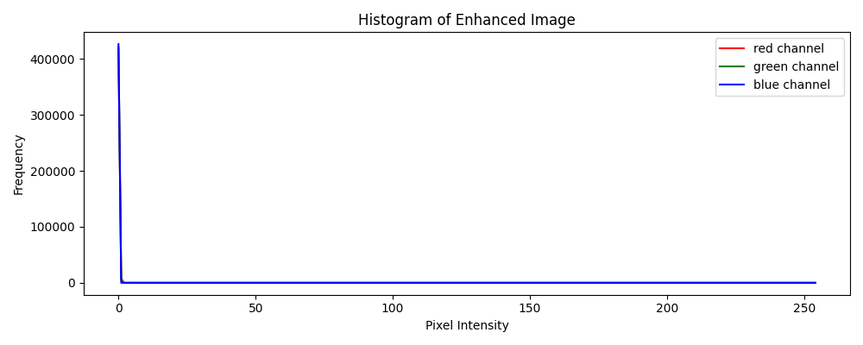
Histogram for Enhanced Image

Slide 11
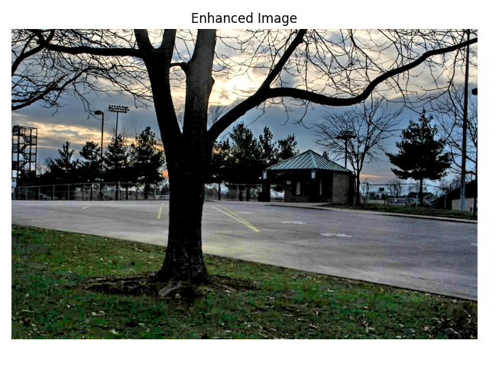
Final Output → Enhanced Image

Slide 12
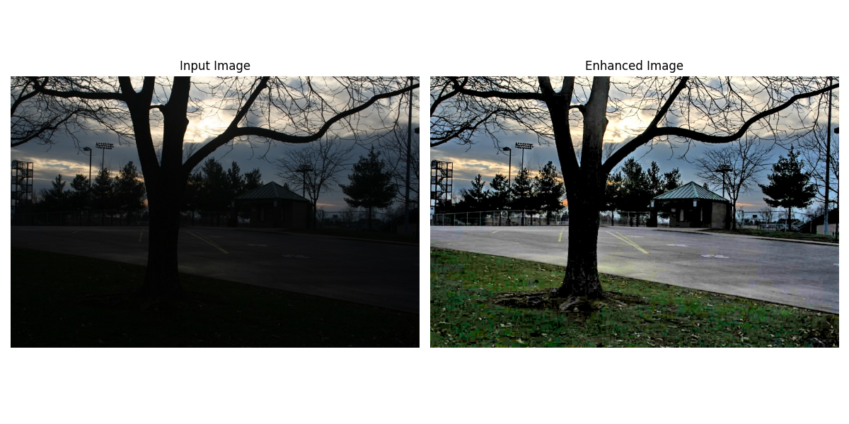
Figure-1

Slide 13
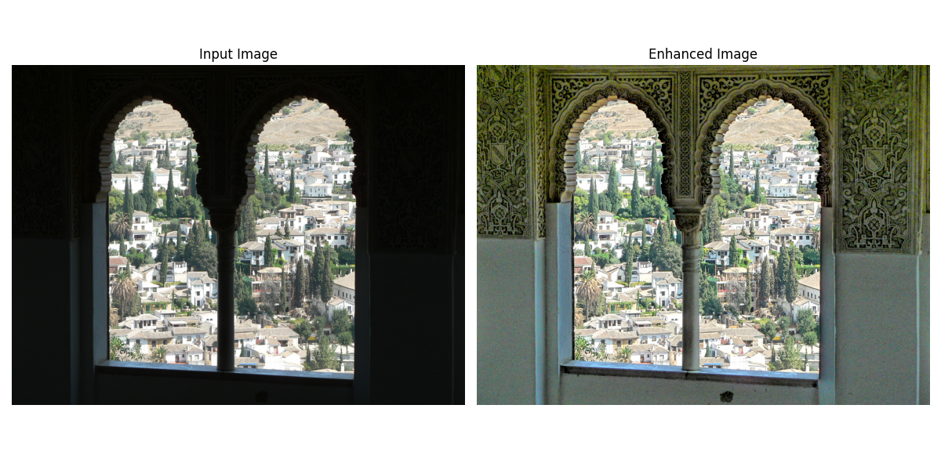
Figure-2

Slide 14
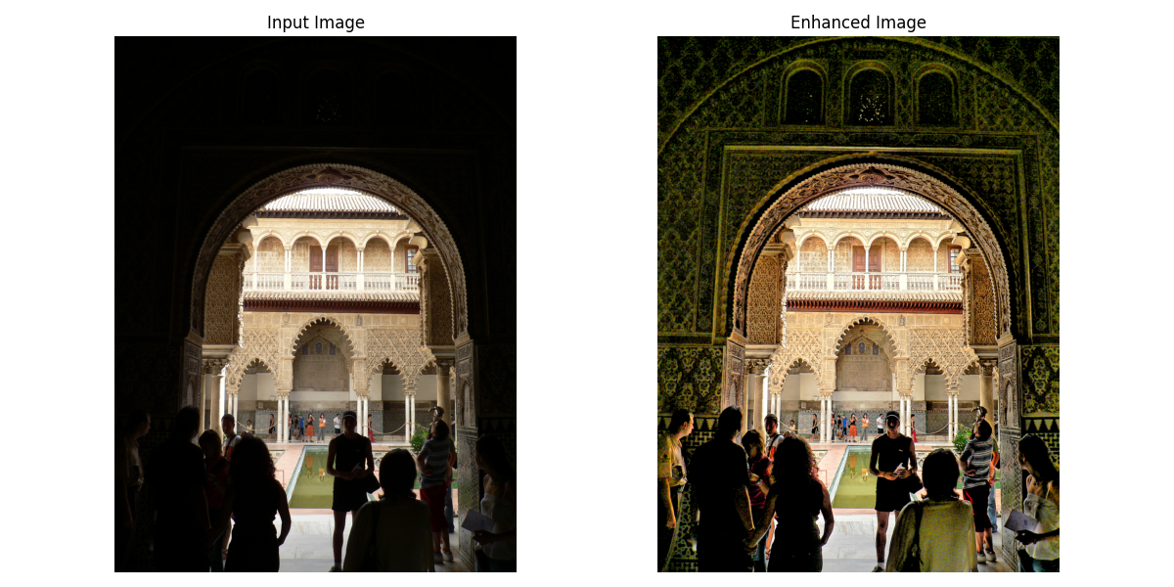
Figure-3

Slide 15
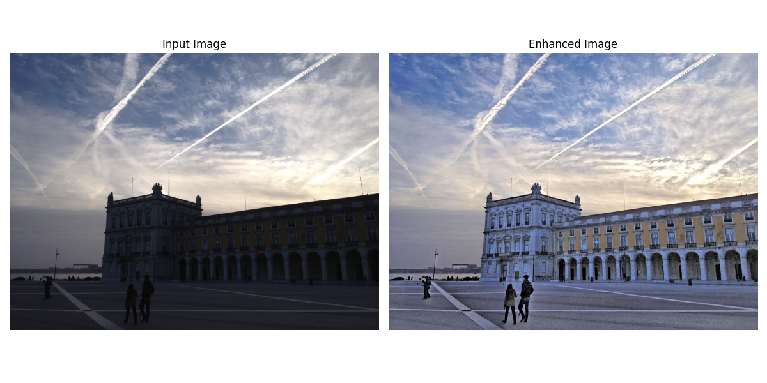
Figure-4

Slide 16
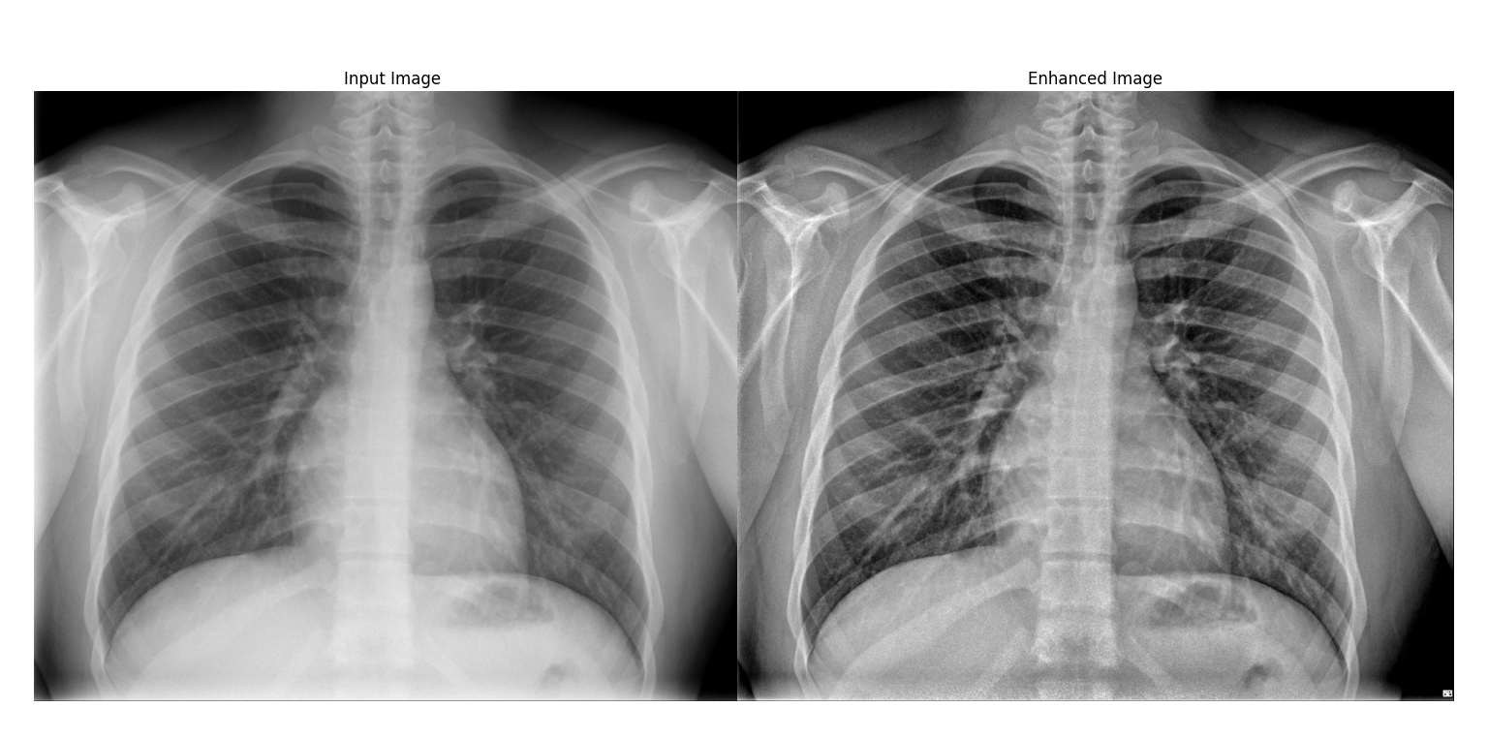
Figure-5

Slide 17
Conclusion
Results: Improved image quality by applying these techniques.
Future Work:
Explore more advanced image processing techniques.
Implement optimizations for performance and quality.
Experiment with machine learning-based methods for automatic parameter adjustment.

Slide 18


